Slide 1
Unit 3: Greedy Method

Slide 2







Coin Changing
Goal. Given currency denominations: 1, 5, 10, 25, 100, devise a method to pay amount to customer using fewest number of coins.
Ex: 34¢.
Cashier's algorithm. At each iteration, add coin of the largest value that does not take us past the amount to be paid.
Ex: $2.89.
Notes:
most of us solve this kind of problem every day without thinking twice, unconsciously using an obvious greedy algorithm
http://www.frbatlanta.org/publica/brochure/fundfac/html/coinfaces.html

Slide 3
(1,3,5,6,9,2) largest number Monopoly games with different denomination currency(banker) activity with start time and finish time
Coin exchange problem-shopkeeper needs to give change 100 rs where amount to b paid is 71

Slide 4
Greedy – General Method
The greedy approach suggests
constructing a solution through a sequence of steps
each expanding a partially constructed solution obtained so far,
until a complete solution to the problem is reached.
On each step the choice made must be:
feasible, i.e., it has to satisfy the problem’s constraints
locally optimal, i.e., it has to be the best local choice among all feasible choices available on that step
irrevocable, i.e., once made, it cannot be changed on subsequent steps of the algorithm

Slide 5
General method
Given n inputs choose a subset that satisfies some constraints.
A subset that satisfies the constraints is called a feasible solution.
A feasible solution that maximises or minimises a given (objective) function is said to be optimal.
Often it is easy to find a feasible solution but difficult to find the optimal solution
Greedy algorithm
An algorithm is greedy if it builds up a solution in small steps, choosing a decision at each step myopically to optimize some underlying criterion. One can often design many different greedy algorithms for the same problem, each one locally, incrementally optimizing some different measure on its way to a solution.

Slide 6
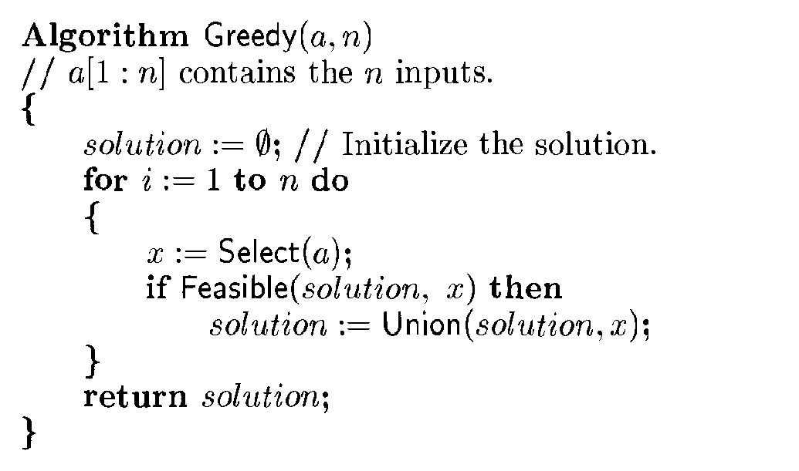
Greedy Method

Slide 7
Coin Change Problem
Problem Statement:
Given coins of several denominations find out a way to give a customer an amount with fewest number of coins.

Slide 8
Coin Change Problem
Example: if denominations are 1, 5, 10, 25 and 100 and the change required is 30, the solutions are,
Amount : 30 Solutions :
3 x 10 ( 3 coins )
6 x 5 ( 6 coins )
1 x 25 + 5 x 1 ( 6 coins )
1 x 25 + 1 x 5 ( 2 coins )
The last solution is the optimal one as it gives us change only with 2 coins.

Slide 9
Coin Change Problem
Solution for coin change problem using greedy algorithm is very intuitive and called as cashier’s algorithm.
Basic principle is:
At every iteration for search of a coin, take the largest coin which can fit into remain amount to be changed at that particular time.
At the end you will have optimal solution.

Slide 10


Coin Changing
Greed is good. Greed is right. Greed works. Greed clarifies, cuts through, and captures the essence of the evolutionary spirit.
- Gordon Gecko (Michael Douglas)
Notes:
"michael douglas played gordon gecko in iconic movie of the 1980's that embodied Reagan era"
also starring charlie and martin sheen, directed by Oliver Stone

Slide 11
Coin Changing
Goal. Given currency denominations: 1, 5, 10, 25, 100, devise a method to pay amount to customer using fewest number of coins.
Ex: 34¢.
Cashier's algorithm. At each iteration, add coin of the largest value that does not take us past the amount to be paid.
Ex: $2.89.
Notes:
most of us solve this kind of problem every day without thinking twice, unconsciously using an obvious greedy algorithm
http://www.frbatlanta.org/publica/brochure/fundfac/html/coinfaces.html

Slide 12
Coin-Changing: Greedy Algorithm
Cashier's algorithm. At each iteration, add coin of the largest value that does not take us past the amount to be paid.
Q. Is cashier's algorithm optimal?
Sort coins denominations by value: c₁ < c₂ < … < c_{n}.
S ← φ
while (x ≠ 0) {
let k be largest integer such that c_{k} ≤ x
if (k = 0)
return "no solution found"
x ← x - c_{k}
S ← S ∪ {k}
}
return S
coins selected
Notes:
takes O(n log n) + |S| where S is the number of coins taken by greedy
Note: can be sped up somewhat by using integer division

Slide 13
Coin-Changing: Analysis of Greedy Algorithm
Theorem. Greed is optimal for U.S. coinage: 1, 5, 10, 25, 100.
Pf. (by induction on x)
Consider optimal way to change c_{k} ≤ x < c_{k+1} : greedy takes coin k.
We claim that any optimal solution must also take coin k.
if not, it needs enough coins of type c₁, …, c_{k-1} to add up to x
table below indicates no optimal solution can do this
Problem reduces to coin-changing x - c_{k} cents, which, by induction, is optimally solved by greedy algorithm. ▪
k
c_{k}
All optimal solutions must satisfy
Max value of coins 1, 2, …, k-1 in any OPT
1
1
P ≤ 4
-
2
5
N ≤ 1
4
3
10
N + D ≤ 2
4 + 5 = 9
4
25
Q ≤ 3
20 + 4 = 24
5
100
no limit
75 + 24 = 99
Notes:
P = pennies, N = nickels, D = dimes, Q = quarters

Slide 14
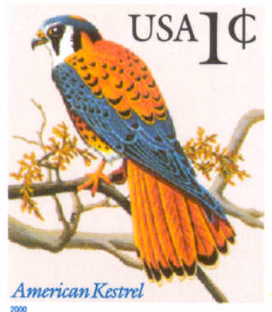
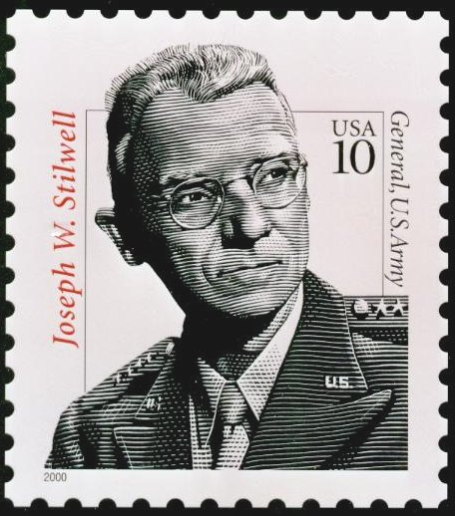

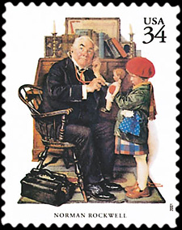




Coin-Changing: Analysis of Greedy Algorithm
Observation. Greedy algorithm is sub-optimal for US postal denominations: 1, 10, 21, 34, 70, 100, 350, 1225, 1500.
Counterexample. 140¢.
Greedy: 100, 34, 1, 1, 1, 1, 1, 1.
Optimal: 70, 70.
Notes:
note: may not even lead to *feasible* solution if c_1 > 1!
Ex. C = {7, 8, 9}, x = 15

Slide 15
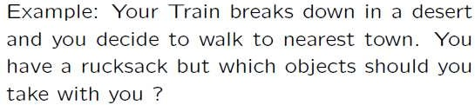
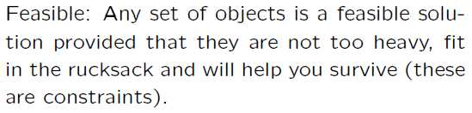

Slide 16
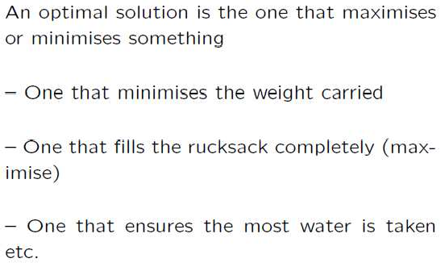
13

Slide 17
Interval Scheduling
Interval scheduling.
Job j starts at s_{j} and finishes at f_{j}.
Two jobs compatible if they don't overlap.
Goal: find maximum subset of mutually compatible jobs.
a
b
c
d
e
f
g
h
Time
0
1
2
3
4
5
6
7
8
9
10
11
Notes:
Activity selection = interval scheduling
OPT = B, E, H
Note: smallest job (C) is not in any optimal solution, job that starts first (A) is not in any optimal solution.

Slide 18
Interval Scheduling: Greedy Algorithms stays ahead
Greedy template. Consider jobs in some natural order. Take each job provided it's compatible with the ones already taken.
[Earliest start time] Consider jobs in ascending order of s_{j}.
[Earliest finish time] Consider jobs in ascending order of f_{j}.
[Shortest interval] Consider jobs in ascending order of f_{j} - s_{j}.
[Fewest conflicts] For each job j, count the number of conflicting jobs c_{j}. Schedule in ascending order of c_{j}.

Slide 19
Interval Scheduling: Greedy Algorithms
Greedy template. Consider jobs in some natural order. Take each job provided it's compatible with the ones already taken.
(a)
(b)
(c)
counterexample for earliest start time
counterexample for shortest interval
counterexample for fewest conflicts

Slide 20
Interval Scheduling: Greedy Algorithm
Greedy algorithm. Consider jobs in increasing order of finish time. Take each job provided it's compatible with the ones already taken.
Implementation. O(n log n).
Remember job j* that was added last to A.
Job j is compatible with A if s_{j} ≥ f_{j*}.
Sort jobs by finish times so that f₁ ≤ f₂ ≤ ... ≤ f_{n}.
A ← φ
for j = 1 to n {
if (job j compatible with A)
A ← A ∪ {j}
}
return A
set of jobs selected

Slide 21
Interval Scheduling: Analysis
Theorem. Greedy algorithm is optimal.
Pf. (by contradiction)
Assume greedy is not optimal, and let's see what happens.
Let i₁, i₂, ... i_{k} denote set of jobs selected by greedy.
Let j₁, j₂, ... j_{m} denote set of jobs in the optimal solution with i₁ = j₁, i₂ = j₂, ..., i_{r} = j_{r} for the largest possible value of r.
job i_{r+1} finishes before j_{r+1}
Greedy:
i₁
i₂
i_{r}
i_{r+1}
OPT:
j₁
j₂
j_{r}
j_{r+1}
. . .
why not replace job j_{r+1} with job i_{r+1}?

Slide 22
Interval Scheduling: Analysis
Theorem. Greedy algorithm is optimal.
Pf. (by contradiction)
Assume greedy is not optimal, and let's see what happens.
Let i₁, i₂, ... i_{k} denote set of jobs selected by greedy.
Let j₁, j₂, ... j_{m} denote set of jobs in the optimal solution with i₁ = j₁, i₂ = j₂, ..., i_{r} = j_{r} for the largest possible value of r.
job i_{r+1} finishes before j_{r+1}
Greedy:
i₁
i₂
i_{r}
i_{r+1}
OPT:
j₁
j₂
j_{r}
i_{r+1}
. . .
solution still feasible and optimal, but contradicts maximality of r.

Slide 23
4.1 Interval Partitioning

Slide 24
Interval Partitioning :Scheduling all Intervals
Interval partitioning.
Lecture j starts at s_{j} and finishes at f_{j}.
Goal: find minimum number of classrooms to schedule all lectures so that no two occur at the same time in the same room.
Ex: This schedule uses 4 classrooms to schedule 10 lectures.
4
e
j
3
c
d
g
2
b
h
1
a
f
i
9
9:30
10
10:30
11
11:30
12
12:30
1
1:30
2
2:30
3
3:30
4
4:30
Time

Slide 25
Interval Partitioning
Interval partitioning.
Lecture j starts at s_{j} and finishes at f_{j}.
Goal: find minimum number of classrooms to schedule all lectures so that no two occur at the same time in the same room.
Ex: This schedule uses only 3.
3
c
d
f
j
2
b
g
i
1
a
e
h
9
9:30
10
10:30
11
11:30
12
12:30
1
1:30
2
2:30
3
3:30
4
4:30
Time

Slide 26
Interval Partitioning: Lower Bound on Optimal Solution
Def. The depth of a set of open intervals is the maximum number that contain any given time.
Key observation. Number of classrooms needed ≥ depth.
Ex: Depth of schedule below = 3 ⇒ schedule below is optimal.
Q. Does there always exist a schedule equal to depth of intervals?
a, b, c all contain 9:30
3
c
d
f
j
2
b
g
i
1
a
e
h
9
9:30
10
10:30
11
11:30
12
12:30
1
1:30
2
2:30
3
3:30
4
4:30
Time

Slide 27
Interval Partitioning: Greedy Algorithm
Greedy algorithm. Consider lectures in increasing order of start time: assign lecture to any compatible classroom.
Implementation. O(n log n).
For each classroom k, maintain the finish time of the last job added.
Keep the classrooms in a priority queue.
Sort intervals by starting time so that s₁ ≤ s₂ ≤ ... ≤ s_{n}.
d ← 0
for j = 1 to n {
if (lecture j is compatible with some classroom k)
schedule lecture j in classroom k
else
allocate a new classroom d + 1
schedule lecture j in classroom d + 1
d ← d + 1
}
number of allocated classrooms
Notes:
priority queue keyed by the finish time of the last job added

Slide 28
Interval Partitioning: Greedy Analysis
Observation. Greedy algorithm never schedules two incompatible lectures in the same classroom.
Theorem. Greedy algorithm is optimal.
Pf.
Let d = number of classrooms that the greedy algorithm allocates.
Classroom d is opened because we needed to schedule a job, say j, that is incompatible with all d-1 other classrooms.
These d jobs each end after s_{j}.
Since we sorted by start time, all these incompatibilities are caused by lectures that start no later than s_{j}.
Thus, we have d lectures overlapping at time s_{j} + ε.
Key observation ⇒ all schedules use ≥ d classrooms. ▪

Slide 29
4.2 Scheduling to Minimize Lateness

Slide 30
Scheduling to Minimizing Lateness:An Exchange Argument
Minimizing lateness problem.
Single resource processes one job at a time.
Job j requires t_{j} units of processing time and is due at time d_{j}.
If j starts at time s_{j}, it finishes at time f_{j} = s_{j} + t_{j}.
Lateness: l_{j} = max { 0, f_{j} - d_{j} }.
Goal: schedule all jobs to minimize maximum lateness L = max_{j} l_{i}
Ex:
1
2
3
4
5
6
t_{j}
3
2
1
4
3
2
d_{j}
6
8
9
9
14
15
lateness = 2
lateness = 0
max lateness = 6
d₃ = 9
d₂ = 8
d₆ = 15
d₁ = 6
d₅ = 14
d₄ = 9
0
1
2
3
4
5
6
7
8
9
10
11
12
13
14
15
Notes:
Note: finding a maximal size subset of jobs that meet deadline is NP-hard.

Slide 31
Minimizing Lateness: Greedy Algorithms
Greedy template. Consider jobs in some order.
[Shortest processing time first] Consider jobs in ascending order of processing time t_{j}.
[Earliest deadline first] Consider jobs in ascending order of deadline d_{j}.
[Smallest slack] Consider jobs in ascending order of slack d_{j} - t_{j}.

Slide 32
Minimizing Lateness: Greedy Algorithms
Greedy template. Consider jobs in some order.
[Shortest processing time first] Consider jobs in ascending order of processing time t_{j}.
Req:1,2
tj:1,3
dj:2,5
[Smallest slack] Consider jobs in ascending order of slack d_{j} - t_{j}.
1
2
t_{j}
1
10
counterexample
d_{j}
100
10
1
2
t_{j}
1
10
counterexample
d_{j}
2
10

Slide 33
Minimizing Lateness: Greedy Algorithm
Greedy algorithm. Earliest deadline first.
Sort n jobs by deadline so that d₁ ≤ d₂ ≤ … ≤ d_{n}
t ← 0
for j = 1 to n
Assign job j to interval [t, t + t_{j}]
s_{j} ← t, f_{j} ← t + t_{j}
t ← t + t_{j}
output intervals [s_{j}, f_{j}]
max lateness = 1
d₁ = 6
d₂ = 8
d₃ = 9
d₄ = 9
d₅ = 14
d₆ = 15
0
1
2
3
4
5
6
7
8
9
10
11
12
13
14
15

Slide 34
Minimizing Lateness: No Idle Time
Observation. There exists an optimal schedule with no idle time.
Observation. The greedy schedule has no idle time.
d = 4
d = 6
d = 12
0
1
2
3
4
5
6
7
8
9
10
11
d = 4
d = 6
d = 12
0
1
2
3
4
5
6
7
8
9
10
11
Notes:
"machine not working for some reason, yet work still to be done"

Slide 35
Minimizing Lateness: Inversions
Def. Given a schedule S, an inversion is a pair of jobs i and j such that: i < j but j scheduled before i.
Observation. Greedy schedule has no inversions.
Observation. If a schedule (with no idle time) has an inversion, it has one with a pair of inverted jobs scheduled consecutively.
inversion
f_{i}
before swap
j
i
[ as before, we assume jobs are numbered so that d₁ ≤ d₂ ≤ … ≤ d_{n} ]
Notes:
Recall: jobs sorted in ascending order of due dates

Slide 36
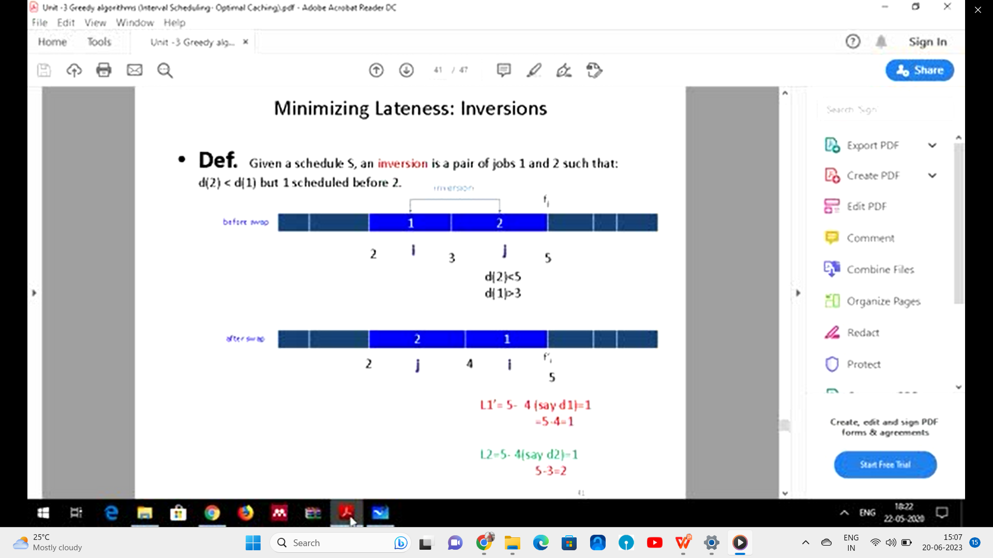
Lateness Calculation Before Swap:𝐿1
L1' (lateness of job 1): Calculate the time when job 1 finishes and subtract its due date.
L1' = Finish time of job 1 - 𝑑(1)
Example: 𝐿1
L1' = 5 (finish time) - 4 (due date) = 1
L2' (lateness of job 2): Calculate the time when job 2 finishes and subtract its due date.
𝐿2
L2' = Finish time of job 2 - 𝑑(2)
Example: 𝐿2
L2' = 5 (finish time) - 3 (due date) = 2

Slide 37
Minimizing Lateness: Inversions
Def. Given a schedule S, an inversion is a pair of jobs i and j such that: i < j but j scheduled before i.
Claim. Swapping two consecutive, inverted jobs reduces the number of inversions by one and does not increase the max lateness.
Pf. Let l be the lateness before the swap, and let l ' be it afterwards.
● l'_{k} = l_{k} for all k ≠ i, j
l ' _{j}≤ l _{j}
If job j is late:
inversion
f_{i}
before swap
j
i
after swap
i
j
f'_{j}
Notes:
fi - di <= max {0, fi - di} = li

Slide 38
Minimizing Lateness: Analysis of Greedy Algorithm
Theorem. Greedy schedule S is optimal.
Pf. Define S* to be an optimal schedule that has the fewest number of inversions, and let's see what happens.
Can assume S* has no idle time.
If S* has no inversions, then S = S*.
If S* has an inversion, let i-j be an adjacent inversion.
swapping i and j does not increase the maximum lateness and strictly decreases the number of inversions
this contradicts definition of S* ▪

Slide 39
Greedy Analysis Strategies
Greedy algorithm stays ahead. Show that after each step of the greedy algorithm, its solution is at least as good as any other algorithm's.
Structural. Discover a simple "structural" bound asserting that every possible solution must have a certain value. Then show that your algorithm always achieves this bound.
Exchange argument. Gradually transform any solution to the one found by the greedy algorithm without hurting its quality.
Other greedy algorithms. Kruskal, Prim, Dijkstra, Huffman, …
Notes:
Hard, if not impossible, to precisely define "greedy algorithm." Though there are some formalizations, e.g., matroids.
myopic
greed: "at every iteration, the algorithm chooses the best morsel it can swallow, without worrying about the future"
Objective function. Does not explicitly appear in greedy algorithm!

Slide 40
4.3 Optimal Caching

Slide 41
Optimal Offline Caching
Caching.
Cache with capacity to store k items.
Sequence of m item requests d₁, d₂, …, d_{m}.
Cache hit: item already in cache when requested.
Cache miss: item not already in cache when requested: must bring requested item into cache, and evict some existing item, if full.
Goal. Eviction schedule that minimizes number of cache misses.
Ex: k = 2, initial cache = ab, requests: a, b, c, b, c, a, a, b.
Optimal eviction schedule: 2 cache misses.
blue = cache miss
a
a
b
b
a
b
c
c
b
b
c
b
c
c
b
a
a
b
a
a
b
b
a
b
requests
cache

Slide 42
Optimal Offline Caching: Farthest-In-Future
Farthest-in-future. Evict item in the cache that is not requested until farthest in the future.
Theorem. [Bellady, 1960s] FF is optimal eviction schedule.
Pf. Algorithm and theorem are intuitive; proof is subtle.
current cache:
a
b
c
d
e
f
future queries:
g a b c e d a b b a c d e a f a d e f g h ...
cache miss
eject this one

Slide 43
Reduced Eviction Schedules
Claim. Given any unreduced schedule S, can transform it into a reduced schedule S' with no more cache misses.
Pf. (by induction on number of unreduced items)
Suppose S brings d into the cache at time t, without a request.
Let c be the item S evicts when it brings d into the cache.
Case 1: d evicted at time t', before next request for d.
Case 2: d requested at time t' before d is evicted. ▪
doesn't enter cache at requested time
S
S'
S
S'
c
c
c
c
t
t
t
t
d
d
t'
t'
t'
t'
e
d evicted at time t', before next request
e
d requested at time t'
d
Case 1
Case 2
Notes:
Note: can't assume a priori that events in unreduced schedule occur solely at request times

Slide 44
Farthest-In-Future: Analysis
Theorem. FF is optimal eviction algorithm.
Pf. (by induction on number or requests j)
Let S be reduced schedule that satisfies invariant through j requests. We produce S' that satisfies invariant after j+1 requests.
Consider (j+1)^{st} request d = d_{j+1}.
Since S and S_{FF} have agreed up until now, they have the same cache contents before request j+1.
Case 1: (d is already in the cache). S' = S satisfies invariant.
Case 2: (d is not in the cache and S and S_{FF} evict the same element). S' = S satisfies invariant.
Invariant: There exists an optimal reduced schedule S that makes the same eviction schedule as S_{FF} through the first j+1 requests.

Slide 45
Farthest-In-Future: Analysis
Pf. (continued)
Case 3: (d is not in the cache; S_{FF} evicts e; S evicts f ≠ e).
begin construction of S' from S by evicting e instead of f
now S' agrees with S_{FF} on first j+1 requests; we show that having element f in cache is no worse than having element e
j
same
e
f
same
e
f
S
S'
j+1
same
e
d
same
d
f
j
S
S'

Slide 46
Farthest-In-Future: Analysis
Let j' be the first time after j+1 that S and S' take a different action, and let g be item requested at time j'.
Case 3a: g = e. Can't happen with Farthest-In-Future since there must be a request for f before e.
Case 3b: g = f. Element f can't be in cache of S, so let e' be the element that S evicts.
if e' = e, S' accesses f from cache; now S and S' have same cache
if e' ≠ e, S' evicts e' and brings e into the cache; now S and S' have the same cache
must involve e or f (or both)
j'
same
e
same
f
S
S'
Note: S' is no longer reduced, but can be transformed into a reduced schedule that agrees with S_{FF} through step j+1

Slide 47
Farthest-In-Future: Analysis
Let j' be the first time after j+1 that S and S' take a different action, and let g be item requested at time j'.
Case 3c: g ≠ e, f. S must evict e. Make S' evict f; now S and S' have the same cache. ▪
must involve e or f (or both)
j'
same
e
same
f
S
S'
otherwise S' would take the same action
j'
same
g
same
g
S
S'

Slide 48
Caching Perspective
Online vs. offline algorithms.
Offline: full sequence of requests is known a priori.
Online (reality): requests are not known in advance.
Caching is among most fundamental online problems in CS.
LIFO. Evict page brought in most recently.
LRU. Evict page whose most recent access was earliest.
Theorem. FF is optimal offline eviction algorithm.
Provides basis for understanding and analyzing online algorithms.
LRU is k-competitive. [Section 13.8]
LIFO is arbitrarily bad.
FF with direction of time reversed!

Slide 49
Part 2 Greedy algorithms on Graphs

Slide 50
Shortest Path Problem
Shortest path network.
Directed graph G = (V, E).
Source s, destination t.
Length l_{e} = length of edge e.
Shortest path problem: find shortest directed path from s to t.
cost of path = sum of edge costs in path
2
23
3
9
s
18
Cost of path s-2-3-5-t = 9 + 23 + 2 + 16 = 50.
14
2
6
6
30
11
4
19
15
5
5
20
16
6
7
44
t

Slide 51
Dijkstra's Algorithm
Dijkstra's algorithm.
Maintain a set of explored nodes S for which we have determined the shortest path distance d(u) from s to u.
Initialize S = { s }, d(s) = 0.
Repeatedly choose unexplored node v which minimizes add v to S, and set d(v) = π(v).
shortest path to some u in explored part, followed by a single edge (u, v)
_{e}
v
d(u)
u
S
s

Slide 52
Dijkstra's Algorithm
Dijkstra's algorithm.
Maintain a set of explored nodes S for which we have determined the shortest path distance d(u) from s to u.
Initialize S = { s }, d(s) = 0.
Repeatedly choose unexplored node v which minimizes add v to S, and set d(v) = π(v).
shortest path to some u in explored part, followed by a single edge (u, v)
_{e}
v
d(u)
u
S
s
Notes:
S is only needed for the proof of correctness, not the algorithm itself

Slide 53
Dijkstra's Algorithm: Proof of Correctness
Invariant. For each node u ∈ S, d(u) is the length of the shortest s-u path.
Pf. (by induction on |S|)
Base case: |S| = 1 is trivial.
Inductive hypothesis: Assume true for |S| = k ≥ 1.
Let v be next node added to S, and let u-v be the chosen edge.
The shortest s-u path plus (u, v) is an s-v path of length π(v).
Consider any s-v path P. We'll see that it's no shorter
than π(v).
Let x-y be the first edge in P that leaves S, and let P' be the subpath to x.
P is already too long as soon as it leaves S.
P
P'
x
y
s
S
u
●
(P) ≥  (P') +  (x,y) ≥ d(x) +  (x, y) ≥ π(y) ≥ π(v)
v
nonnegative weights
inductive hypothesis
defn of π(y)
Dijkstra chose v instead of y
Notes:
Consider any path P from s to v. It is already at least as long as π(v) by the time it leaves S.

Slide 54
Dijkstra's Algorithm: Implementation
For each unexplored node, explicitly maintain
Next node to explore = node with minimum π(v).
When exploring v, for each incident edge e = (v, w), update
Efficient implementation. Maintain a priority queue of unexplored nodes, prioritized by π(v).
Priority Queue
PQ Operation
Dijkstra
Array
Binary heap
d-way Heap
Fib heap †
Insert
n
n
log n
d log _{d} n
1
ExtractMin
n
n
log n
d log _{d} n
log n
ChangeKey
m
1
log n
log _{d} n
1
IsEmpty
n
1
1
1
1
Total
n²
m log n
m log _{m/n} n
m + n log n
† Individual ops are amortized bounds

Slide 55
DIJKSTRA’S ALGORITHM
PROBLEM
Often when we traverse from one point to another or from one place to another place,we want to know the shortest path.
Given a graph G=(V,E) which models the shortest path problems ,we may want to determine-
Given node u,v what is the shortest u-v path
Given a start node ‘s’ ,what is the shortest path from s to each other node

Slide 56
SET UP OR INPUT INSTANCE SET UP
The edges in the graph has a length l_{e} >=0
l_{e} ->indicate time it takes to traverse e
->usually associated as cost to travel
Take u=1,v=2, l_{e} =1
u=1,v=5
l_{e} ={1,4}+{4,5}=3+4=7
={1,2}+{2,5}=1+5=6
={1,2}+{2,4}+{4,5}
=1+2+4=7
2
1
6
1
33
2
5
3
7
4
5
4

Slide 57




ALGORITHM
//Algorithm:Dijkstra’s Algorithm
1
2

Slide 58
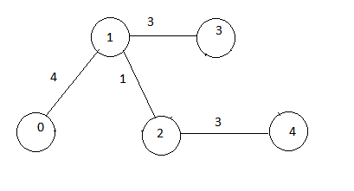
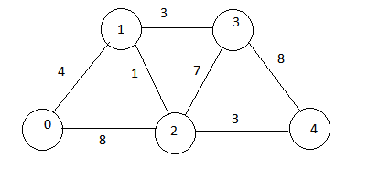

Example
d

Slide 59
Dijkstra’s algorithm example
Source =0
s | Distance[] d[] | Min(d[u]+le)
{0}
0
1
2
3
4
0 | ₉₉₉ | 999 | 999 | 999

Slide 60
Dijkstra’s algorithm example
Source =0
s | Distance[] d[] | Min(d[u]+le)
{0,1} |  | u=0 or u=0 v=1 v=2 min(0+4)=4
0
1
2
3
4
0 | ₄

Slide 61
Dijkstra’s algorithm example
Source =0
s | Distance[] d[] | Min(d[u]+le)
{0,1,2} |  | u=0 or u=1 v=2 v=2 min(0+8)=8 and (4+1)=5
0
1
2
3
4
0 | 4 | 5

Slide 62
Dijkstra’s algorithm example
Source =0
s | Distance[] d[] | Min(d[u]+le)
{0,1,2,3} |  | u=1 or u=2 v=3 v=3 min(4+3)=7 and (4+7)=11
0
1
2
3
4
0 | 4 | 5 | 7

Slide 63
Dijkstra’s algorithm example
Source =0
s | Distance[] d[] | Min(d[u]+le)
{0,1,2,4} |  | u=3 or u=2 v=4 v=4 min(3+8)=11 min(5+3)=8
0
1
2
3
4
0 | 4 | 5 | 7 | 8

Slide 64
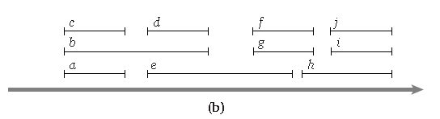
Depth of intervals
the depth of a set of intervals to be the maximum number that pass over any single point on the time-line.

Slide 65
Analysis
In any instance of Interval Partitioning, the number of resources needed is at least the depth of the set of intervals.
Proof. Suppose a set of intervals has depth d, and let I1, . . . , Id all pass over a common point on the time-line.
Then each of these intervals must be scheduled
on a different resource,
so the whole instance needs at least d resources.

